Slide 1
Cars Price Prediction
Submitted by – HARINATH MALLELA

Slide 2
Project Information
With the Covid-19 impact in the market, we have seen lot of changes in the car market.
Now some cars are in demand hence making them costly and some are not in demand hence cheaper.
One of our clients works with small traders, who sell used cars. With the change in market due to Covid-19 impact, our client is facing problems with their previous car price valuation machine learning models.
So, they are looking for new machine learning models from new data. We have to make car price valuation model

Slide 3
Required Libraries
Numpy
Pandas
Sklearn
Matplotlib
Seaborn
Warnings
Regular Expression

Slide 4
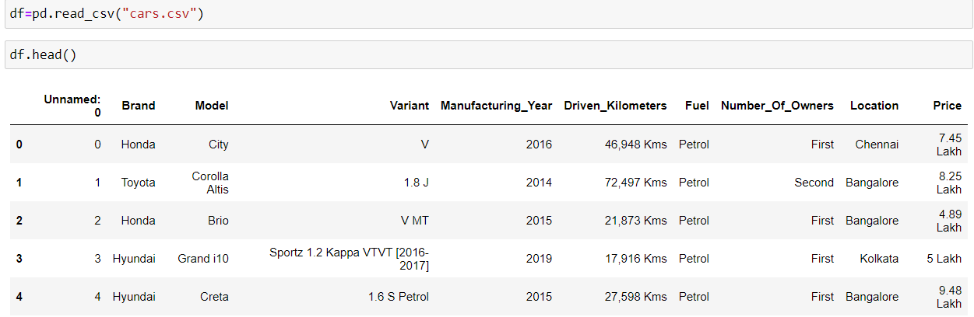
Loading the Dataset

Slide 5
EDA(Exploratory Data Analysis)
There are 9 columns and 5041 rows in the dataset
After doing the feature engineering , there are 8 columns and 5041 rows.
There are null values in this dataset.
Skewness is present in target columns.
Standard deviation is normal in most of the columns.
There is not much difference between mean and 50th percentile, which means data is skewed.
There is not much of difference between 75th percentile and max, which means there are outliers.

Slide 6
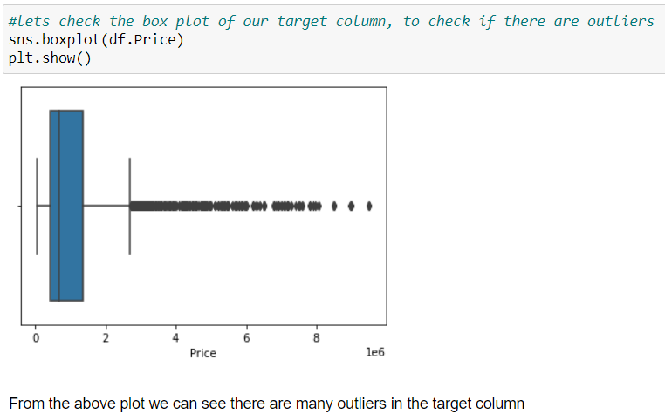
Data Visualization : Outliers in Target Column

Slide 7
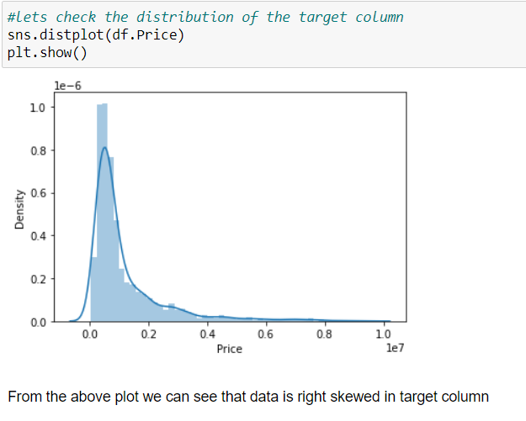
Data Visualization : Distribution of Target Column

Slide 8
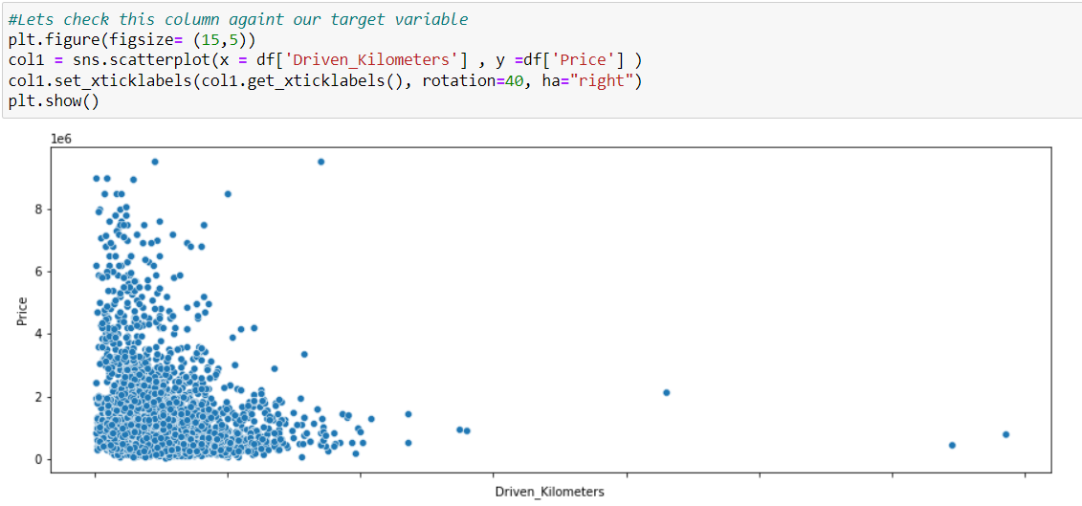
Bivariate Analysis with Target Variable

Slide 9
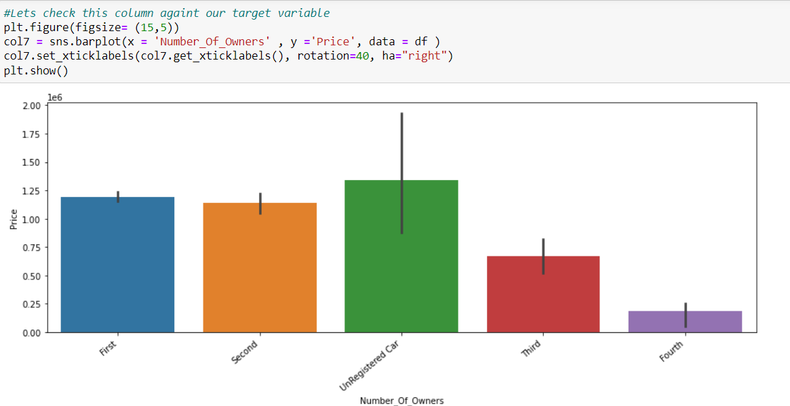
Bivariate Analysis with Target Variable

Slide 10
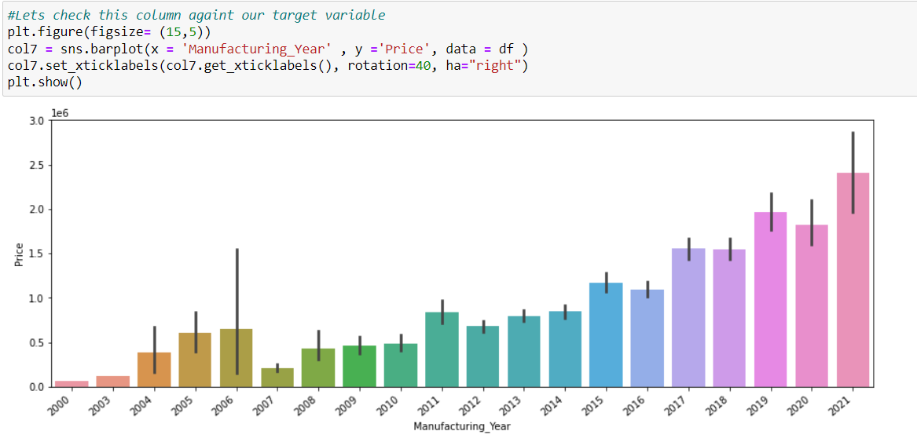
Bivariate Analysis with Target Variable

Slide 11
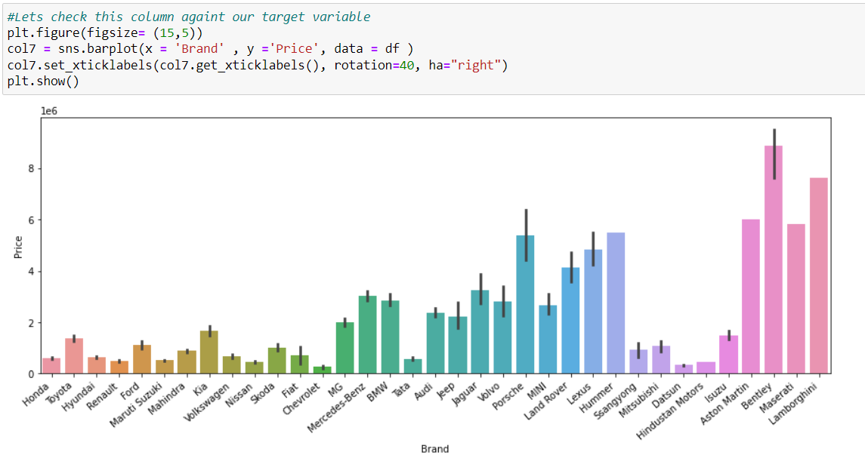
Bivariate Analysis with Target Variable

Slide 12
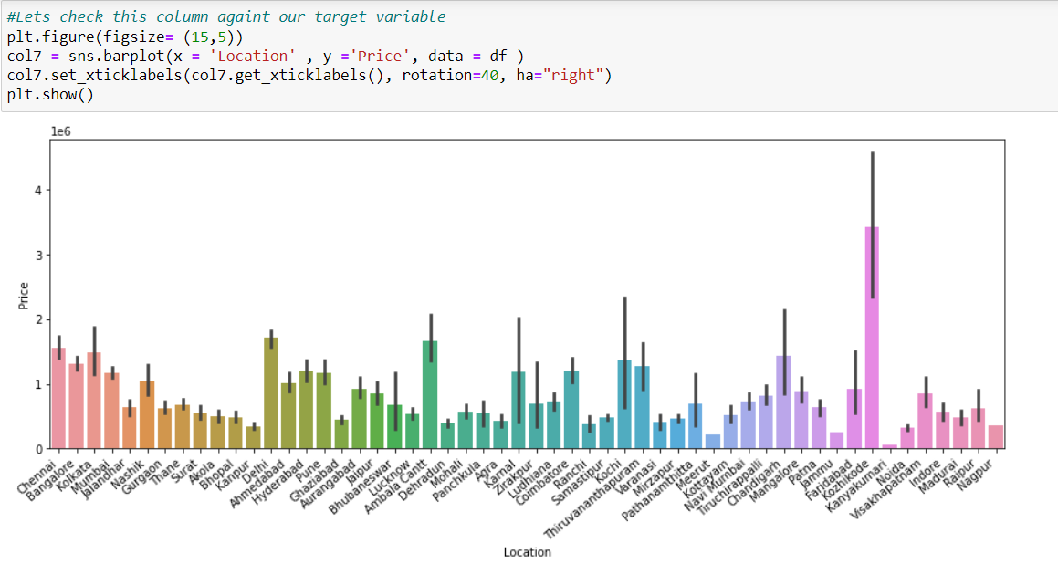
Bivariate Analysis with Target Variable

Slide 13
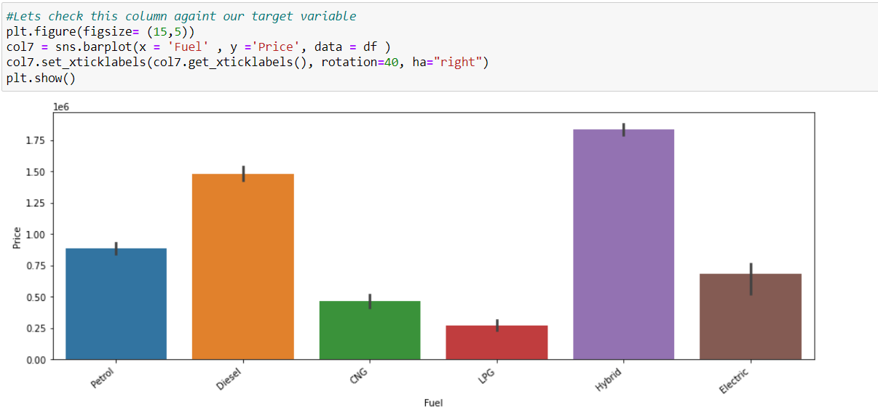
Bivariate Analysis with Target Variable

Slide 14
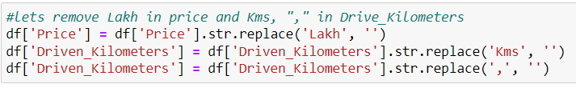
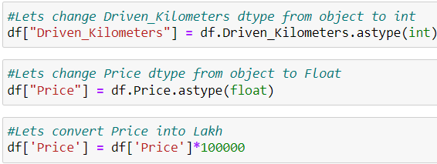
Data Pre-processing :Removing Symobols

Slide 15
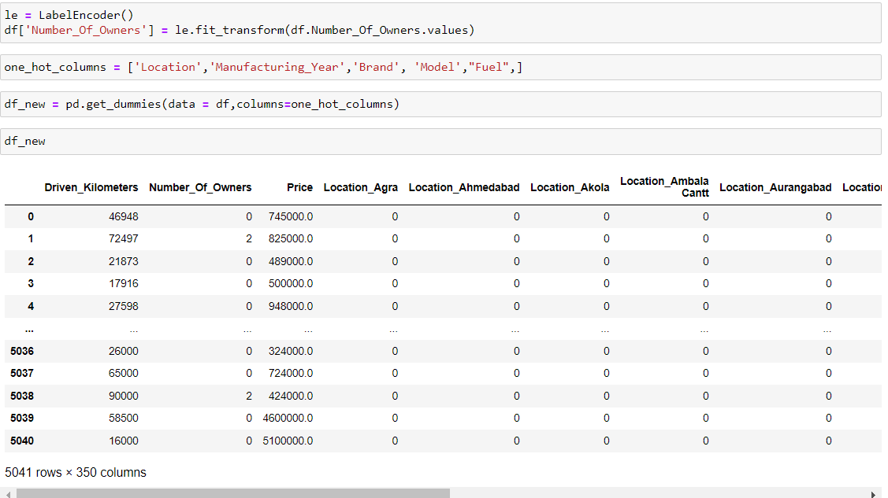
Changing Categorical Values into Numerical Values

Slide 16
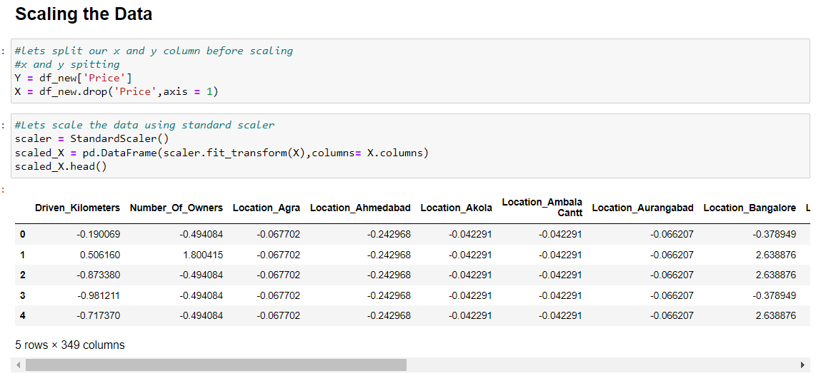
Data Pre-processing :Data Scaling

Slide 17
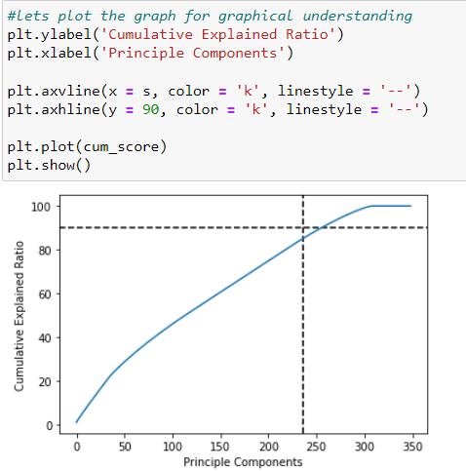
Data Pre-processing :PCA
We used PCA because we have 349 columns in this dataset which is very high.
We should always use scaled data for performing the PCA.
We took 90% data which is equivalent to 256 columns.

Slide 18
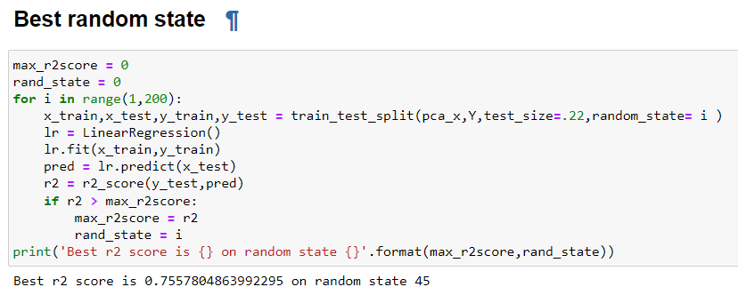
Best Random State

Slide 19
Model Selection
I choose five models to select the best from them.
Decision Tree Regressor
Linear Regression
Random Forest Regressor
AdaBoost Regressor
KNN Regressor

Slide 20
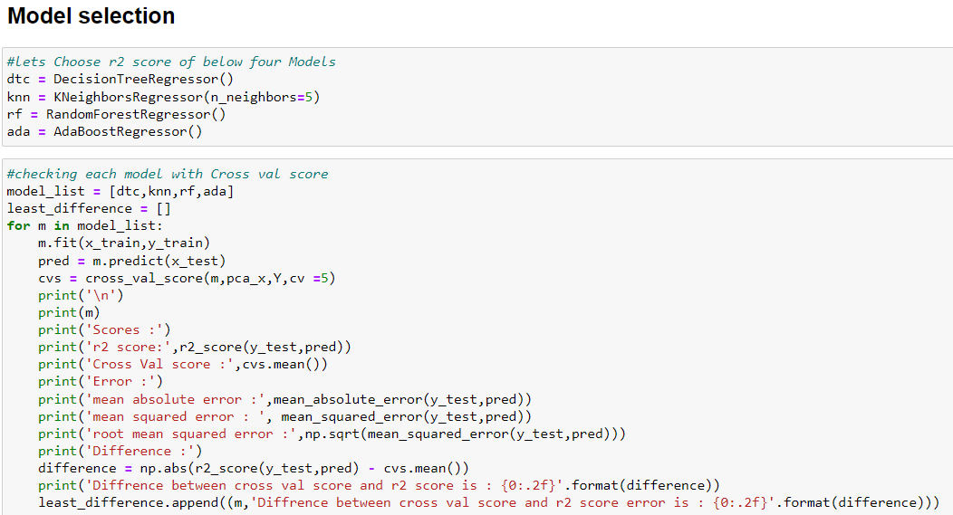
Model Selection : Code

Slide 21
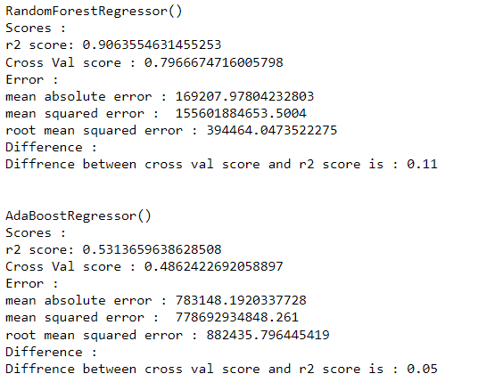
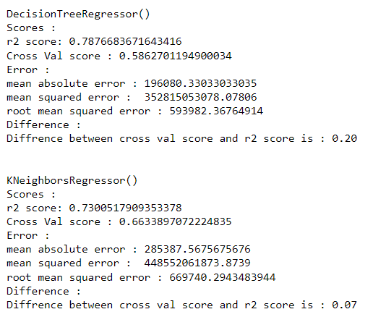
Model Selection : Result

Slide 22
Model Selection
We can see that KNeighbours and Random forest are giving the best R2 Score but the model are slightly overfitted.
We can perform hyper parameter tuning on both KNN and Random Forest .

Slide 23
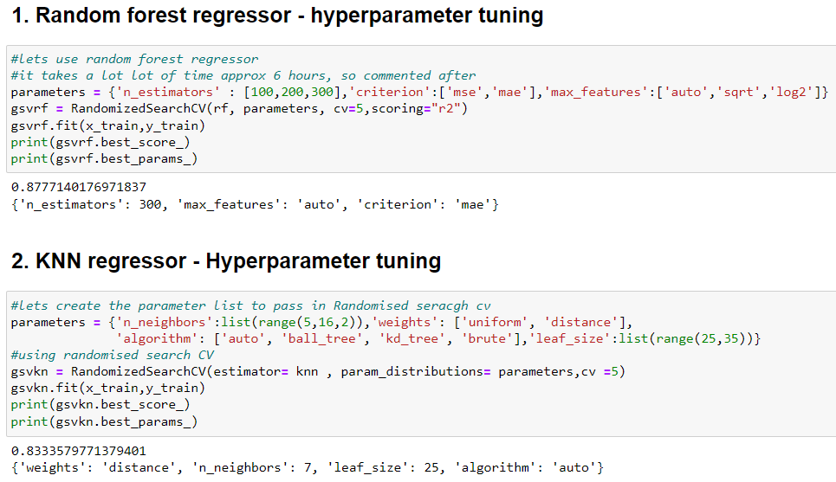
Hyper parameter Tuning :

Slide 24
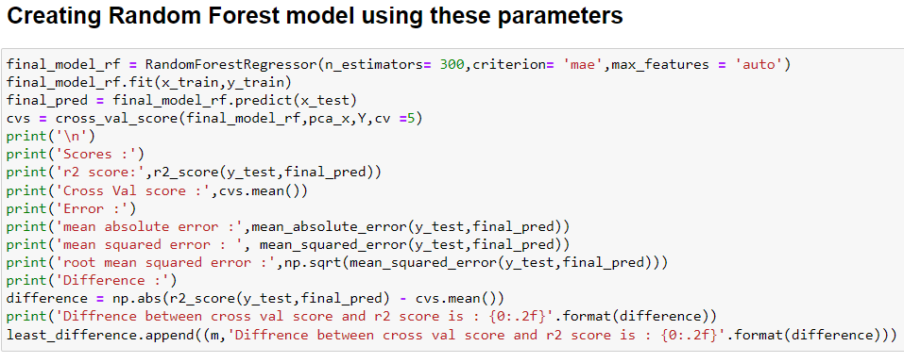
Final Model

Slide 25
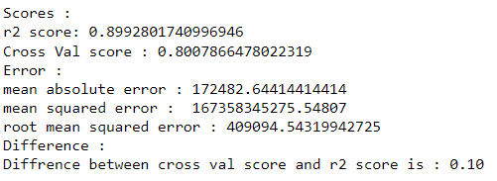
Final Model : Result (Random Forest)

Slide 26
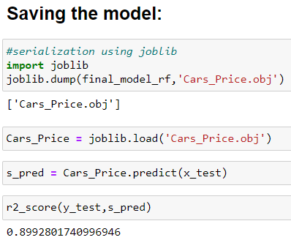
Saving the model:

Slide 27
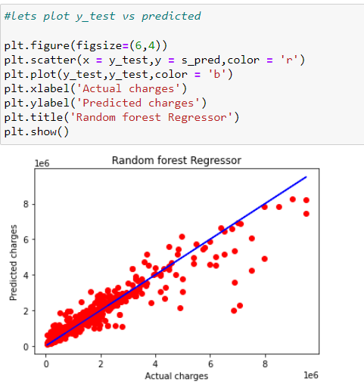
Plotting y_test vs predicted

Slide 28
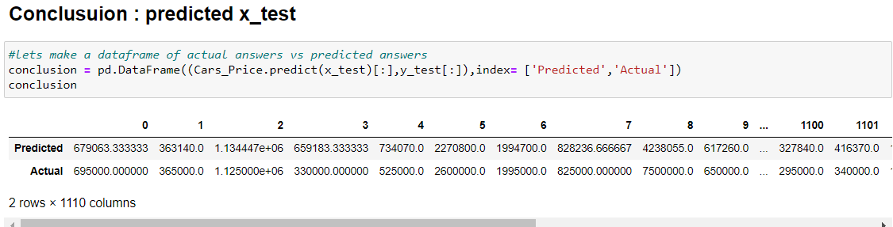
Saving the Results as Dataframe

Slide 29
Conclusion
Though this is the simplest model we’ve built till now, the final predictors still seem to have high correlations.
One can go ahead and remove some of these features, though that will affect the adjusted-r2 score significantly (you should try doing that).
Thus, for now, the final model consists of the 8 variables mentioned above.
Yes there is still room for improvement, like doing a more extensive feature engineering, by comparing and plotting the features against each other and identifying and removing the noisy features.
The values of R-squared obtained from the algorithm give the accuracy of the model. In the future, if more data could be scraped such as the Colour, Scratches, Tyre Condition of cars so predicted results will be more accurate

